Slide 1
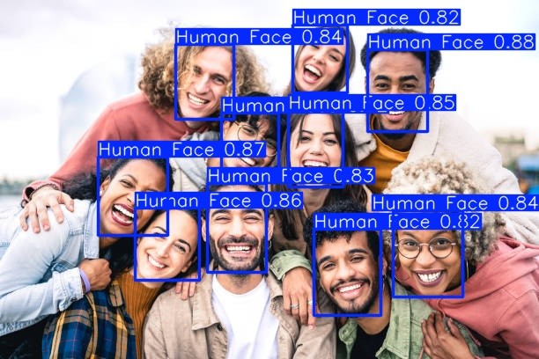
YOLO Implementation
Face Detection Use Case
By: Bahaa El-din Helmy

Slide 2
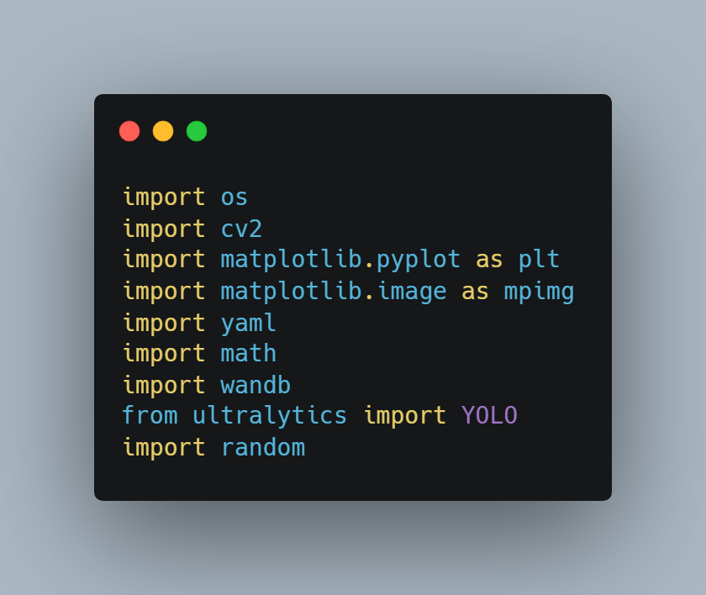
Import Libraries

Slide 3
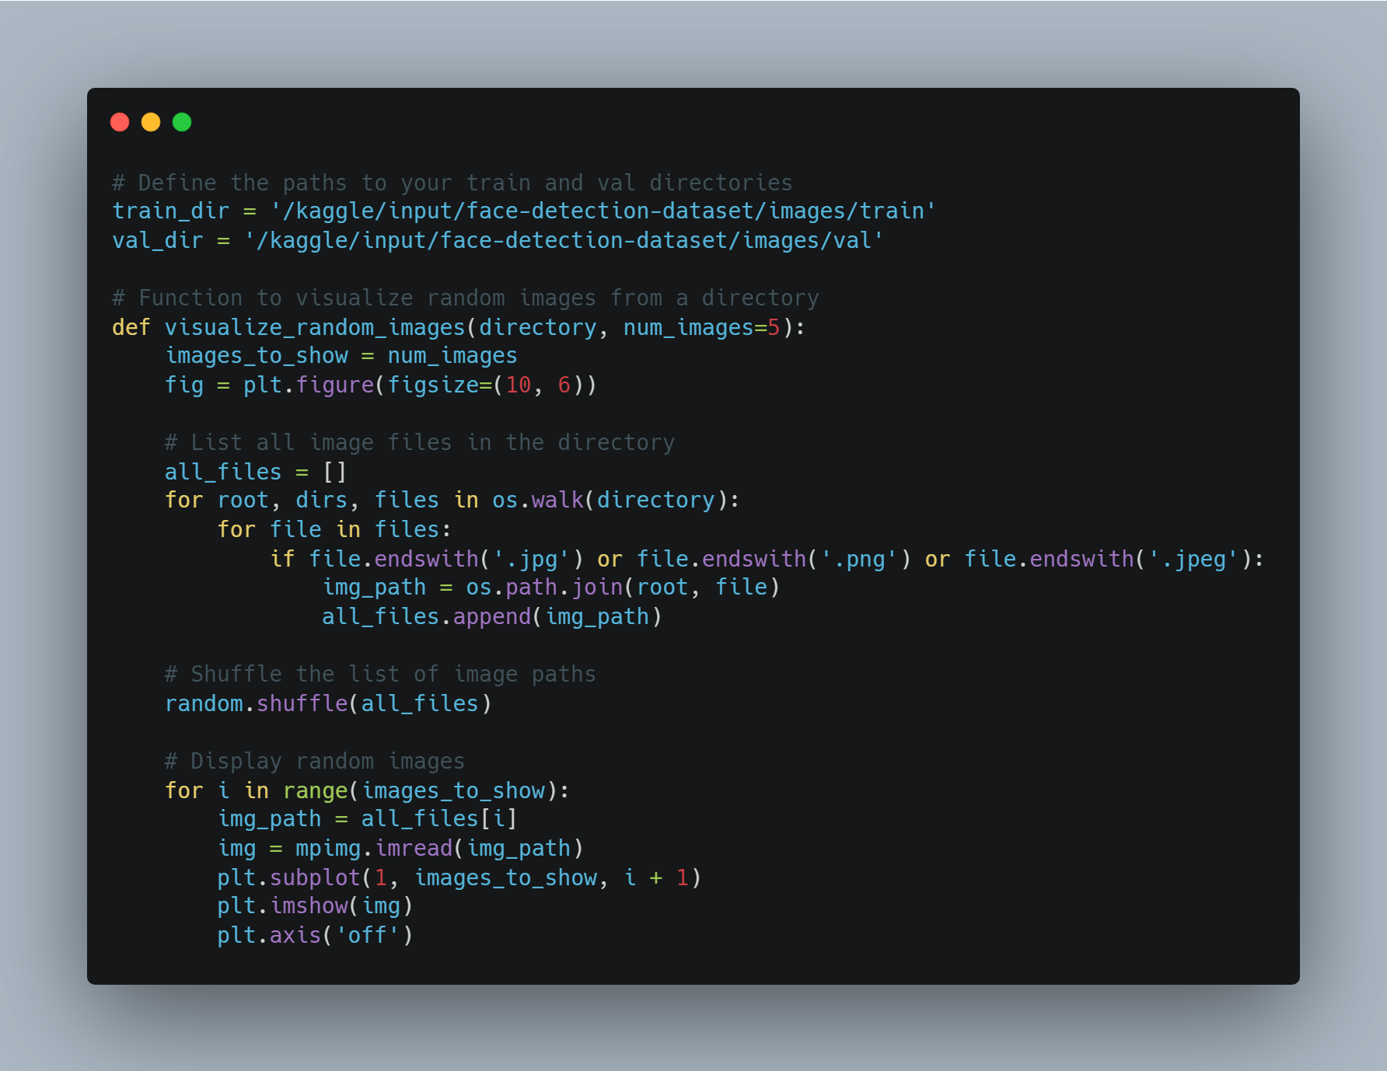

Slide 4
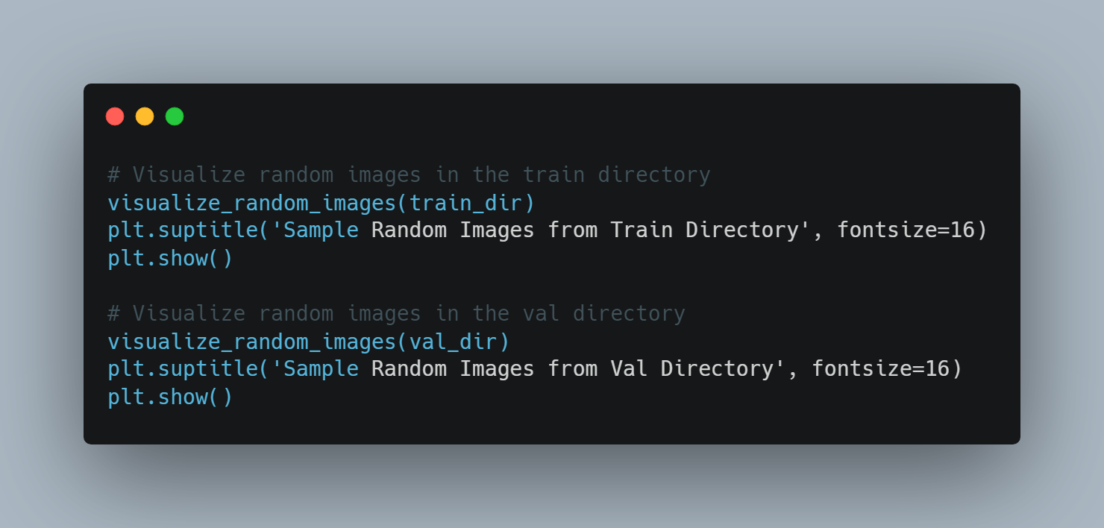

Slide 5
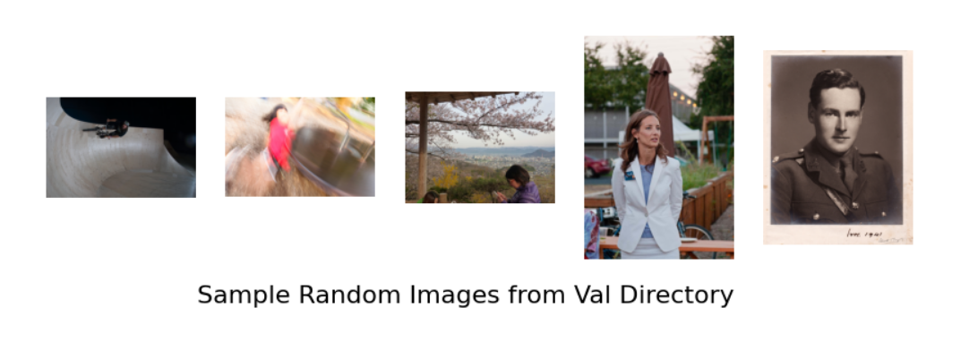

Sample Random Images from Train Directory

Slide 6
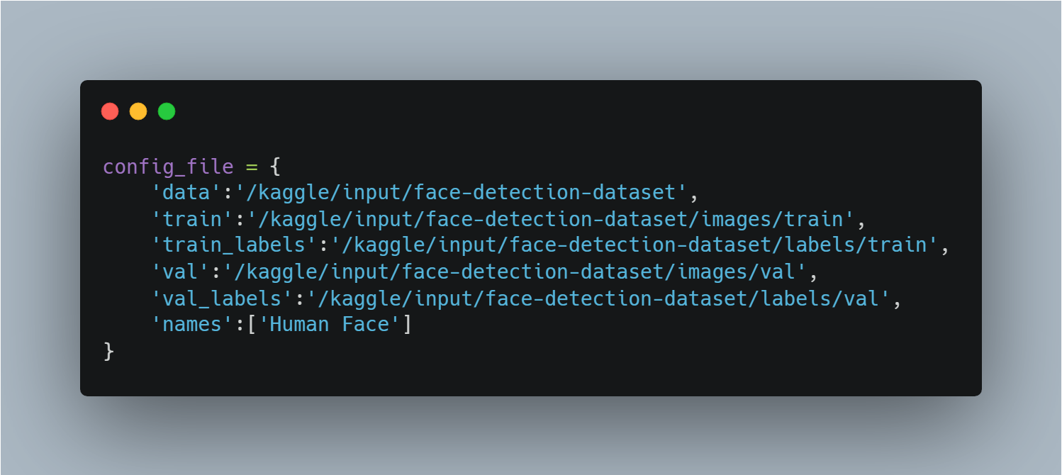
Set Config file and train model

Slide 7
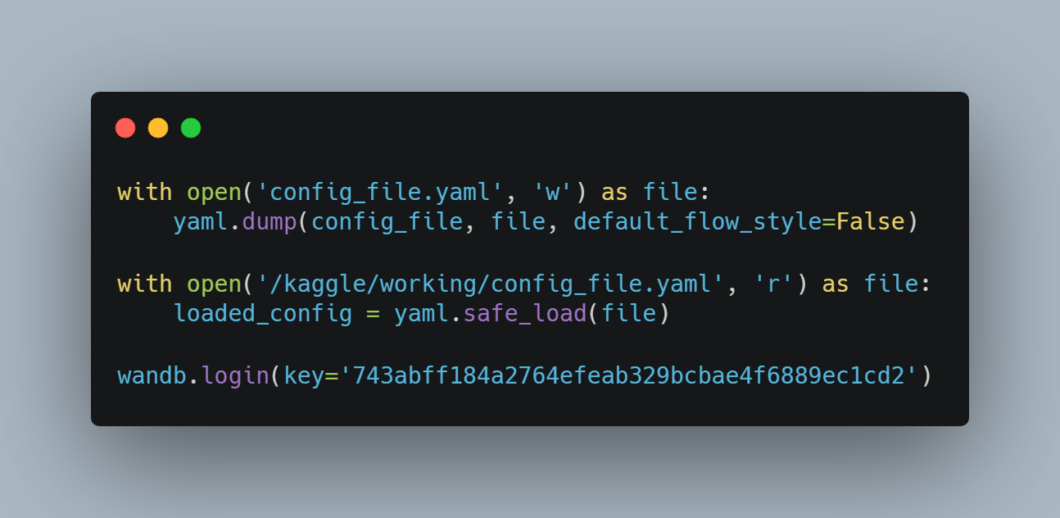

Slide 8

Train the Model

Slide 9

Save the Model

Slide 10
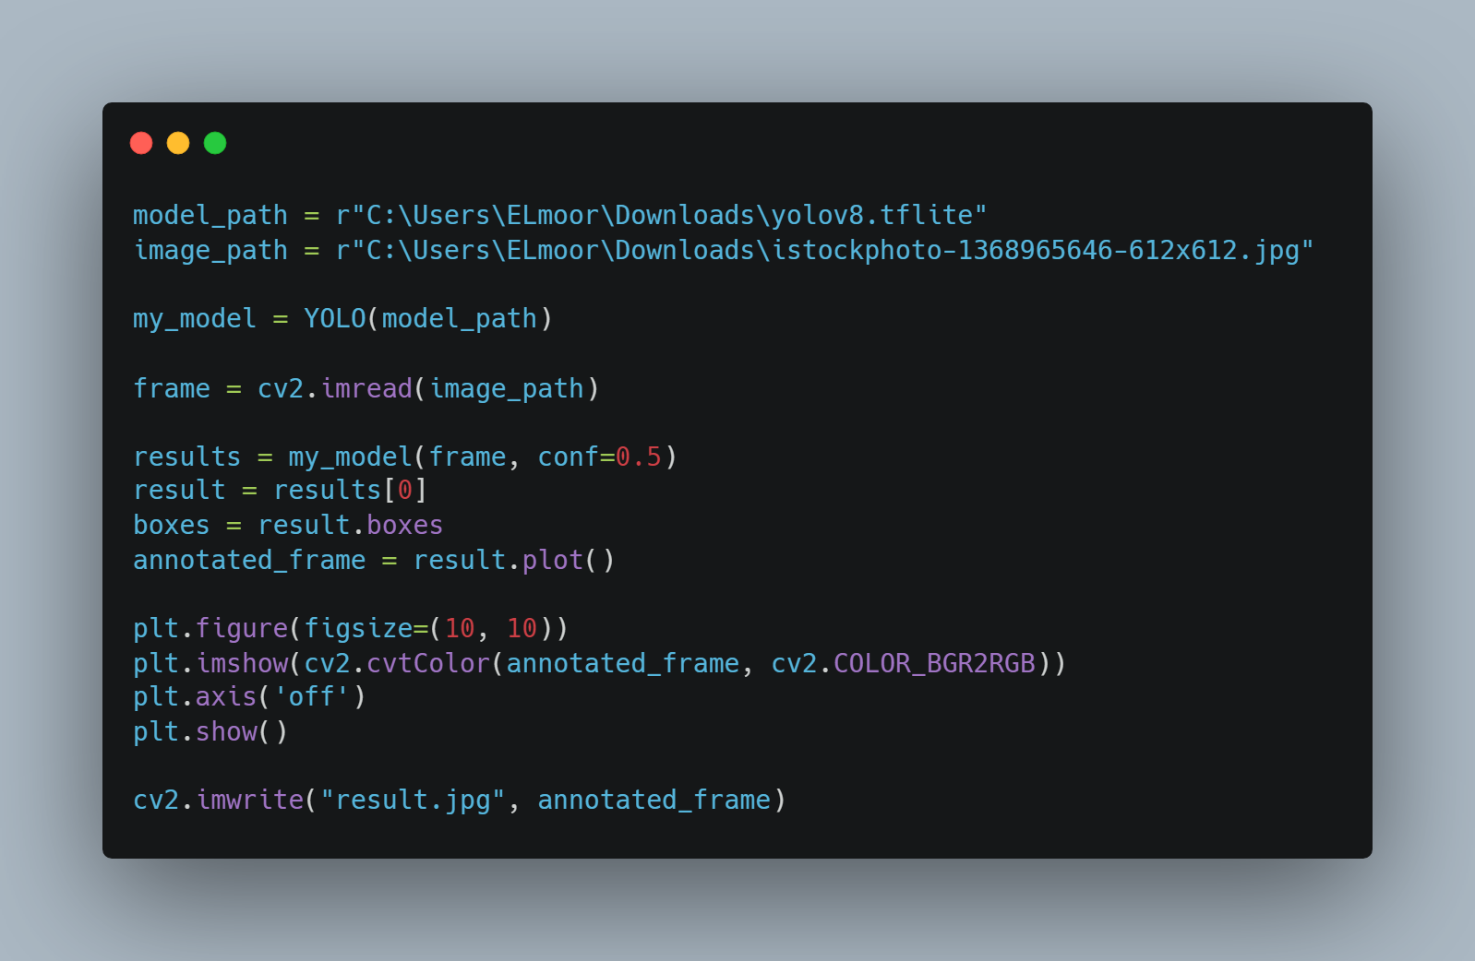
Test the Model

Slide 11
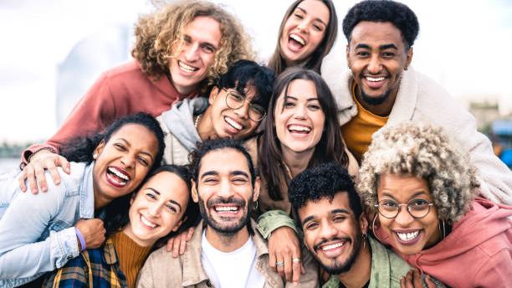

Slide 13
Real Time Inferencing

